Slide 1
Re-Establishing a Classified Senate
San Jose City College
Renewing Hope
Notes:
First go to the helpful website of (4CS) California Community College Classified Senate.
You will find the site helpful with tips , policies and procedures .
The Reference Guide is vital to ones success . It provides structure for a solid foundation.
http://www.ccccs.org/publications/4cs_documents/referenceguidesep02-sm.pdf

Slide 2
Recruitment Strategies
In-person
Email
Word of mouth
Networking
Hope
Notes:
Recruit every opportunity that comes your way. Schedule a time once a week. Get up and get to know your campus.
Email- Find a balance. Send out, but not too often. Don’t drown out the message, but inform the people.
Word of mouth – Encourage others to get involved. Participatory governance is an opportunity. Share some delineation of duties that the senate shares. Example: Standing committee appointments.
Handout Packets- Information about the senate
Professional Development Day – beak –out session
Networking – Take advantage to spread the word at meetings, events, and conferences.
Hope – for the best, and stay optimistic.
Recruitment is very important and on-going.
SHARE: Recruitment Ideas?

Slide 3
Start with creating a constitution
A document that helps your organization with applying rules on how to run your affairs.
Gather a group of people who can dedicate time to brainstorming.
Don’t invent the wheel. Look elsewhere for ideas.
When you’ve completed a rough draft, share with your constituency.
Notes:
purpose of the organization – a few sentences explaining what your senate is about
Membership, meetings & officers – Explain who’ll be a part of your senate and a brief description of their roles & responsibilities, when your senate will meet, who’s considered an officer
Rules for elections, committees and bylaws – how often will you have your elections, how the elections will be handled. What committees will you appoint your constituency and the bylaws that you’ll use to provide
Constitutions are LIVE DOCUMENTS, you can always go back and redefine it as a senate. Nothing is set in stone.
Share and get comments back from everyone. This is a group project

Slide 4
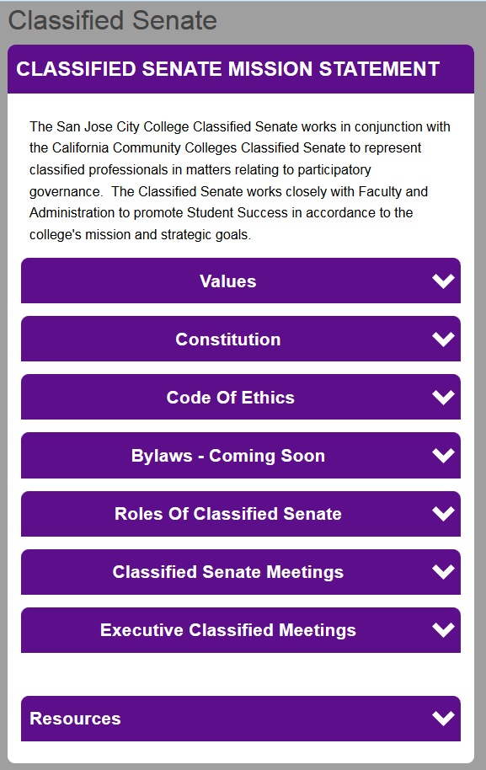
Web Page
Senate Information
Values
Mission Statement
Code of Ethics
Roles of the Classified Senate
More ideas……
Notes:
Consider creating a memorandum of understanding (MOU) with your college and Delineation of duties to clarity the senate responsibilities.
Avoid Union clash or from any other continuant party.

Slide 5
Meeting participation
Get out and talk to someone!
Being consistent is having a successful meeting.
Time is of the essence
You may start off small, but it’ll turn into something BIG!
Notes:
Step out outside of your comfort zone and engage with the people. Ask them questions about what they want to see in their senate. Try to see how you can engage them.
Sticking to a set meeting date and time ensures for better participation. Know that you can’t always please everyone with the time. Come up with other ideas of involving them, even if they can’t join the meeting (conference calls, suggestion boxes)
Expect that your senate is going to start small, but remember that if you stay consistent and keep pushing forward that you will one day be BIG!

Slide 6
Budget
Budget proposal
Volunteer payroll deduction
Notes:
Line item budget proposal is best.
Ask for what you want either by being conservative or radical.
Plan per year by semester.

Slide 7
Senates & unions
Know the difference between the two
Communication is key
Prepare for a long road ahead of you and stay positive!
Some unions may resist change
Notes:
4CS is a great resource! Roles of Classified Senate & Exclusive Bargaining Agents
Try to set up meetings with your union to ensure them of what your senate is about.
Always keep the line of communication clear with your union. If you or them have questions, feel free to reach out to them and let them know you are there to speak with them as well.
Prepare for anything. Some senates have stories of negative unions. Don’t allow this to discourage you. Remember there are always others out there that have had a positive experience. Your senate is very important and is necessary for Accreditation.

Slide 8
Challenges
Opposition
Recruitment
By-in
New employees – green
Old-timers – cynical
Notes:
Opposition - Other groups, past problems, lack of interest.
Recruitment – Again – on-going. Recruit enough members. Focus on the importance of the senate. Educate yourself to educate others.
By-in – from college, staff, faculty, and union . Gain support from all groups.
New- Employees – Fresh perspective , educate them gradually with senate and college information . Express the value of the senate.
Old-Timers – Cynical , we did this before, it won’t last,
WHAT OTHER RESPONCES WOULD SOMEONE HAVE?

Slide 9
By-laws
Rules written for your organization
Provides resolutions to conflicts that may arise.
Focus on keys components that makeup successful by-laws
Notes:
Bylaws are there to assist you when the organization needs structure. They are guidelines for all to follow.
What’s the difference between a constitution and bylaws? A constitution contains the basic principles for which an organization should operate. Bylaws are operational rules or policies that specify exactly how an organization should be operated.
Both contain guidance that you and your members should follow when making decisions that impact the organization and its operation.
Just like the constitution, they are a LIVE DOCUMENT.

Slide 10
Questions and Answers
What would you like to know about starting/
re-establish a Classified Senate?

