Slide 1

CALIFORNIA COMMUNITY COLLEGES
CHANCELLOR’S OFFICE
Presenter: Maureen White, EdD, SPHR
Workforce and Economic Development
State of California June 5, 2015
Classified Leadership Institute
Granlibakken, Tahoe City, CA

Slide 2
Classified ROCK!
A Celebration of Community, Conversation and Transformation of Classified Leadership in Higher Education
Classified Leadership Institute
June 5, 2015

Slide 3
Classified ROCK!
dissertation research methodology and findings that validates and celebrates how Classified, individually and collectively, are taking charge of challenges, changes and creating a thriving 21st century leadership within their “communities of practice;” trans-forming their roles, work, offices, divisions, committees, colleges, districts and statewide.

Slide 4
Classified ROCK!
Maureen’s story
Susie’s story
Research methodologies & models
Conversation: interpretive, transformative
Conversations with Chancellor Harris, Cari Plyley, Trustee, Classified, Faculty, union
Questions, themes, findings
Let’s be conversionate!

Slide 5
Classified ROCK!
Maureen’s story
  Natural, comfortable leader = trust, com(passion)
  Empowering leaders; sharing power, honoring wisdom within individuals, groups, orgs; innate curiosity
  Classified, Certificated, training & prof dev, Administrator, researcher, writer, contributor, co-creator
  Powerful person in not perceived powerful position
  Nonprofit, entertainment, “temporary indefinite,” education since 1988, passion & expertise: career consultant, org dev, workforce dev, connecting
  Social Justice, create community, partnerships, collaboration,, autopoesis (organizing from within)
  Interfaith minister: meaningful work theme

Slide 6
Classified ROCK!
Susie’s story
  “Having responsibility without the authority”
  “Doing the job without the title”
  “Getting the stress without the pay”
  Focused lifelong learning = goals
  Classified identity only, when interviewed
  Moved for job opportunities
  30 years in Los Rios, starting as FA clerk, retiring as tenured professor Work Experience

Slide 7
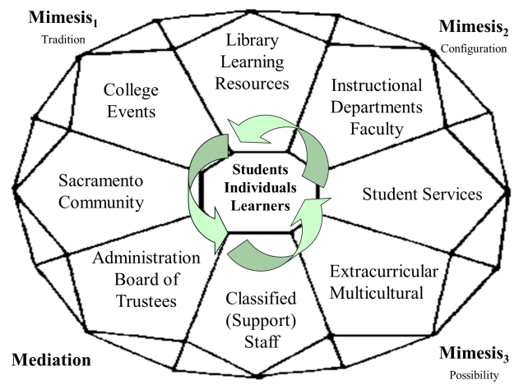
Classified ROCK!

Slide 8
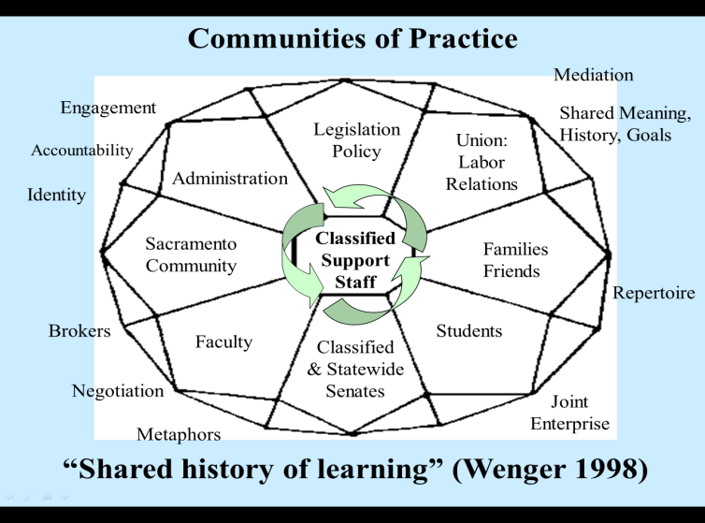
Classified ROCK!

Slide 9
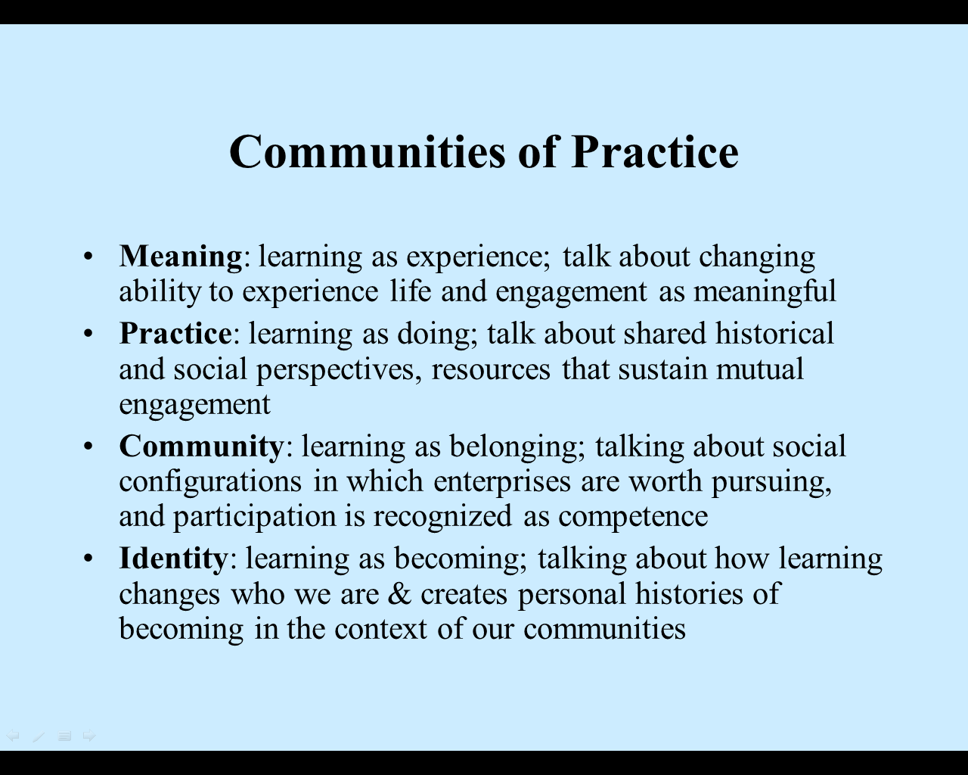
Classified ROCK!

Slide 10
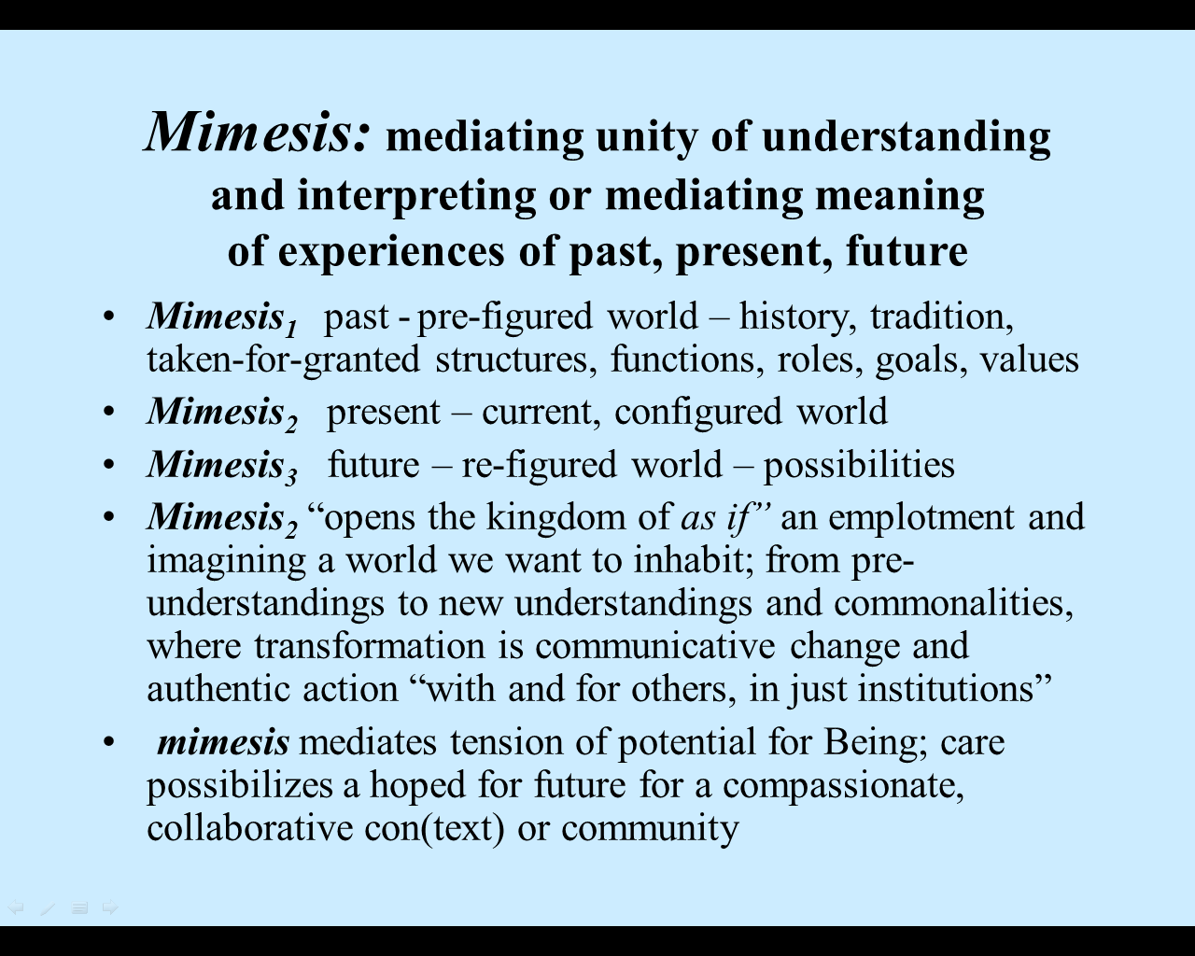
Classified ROCK!

Slide 11
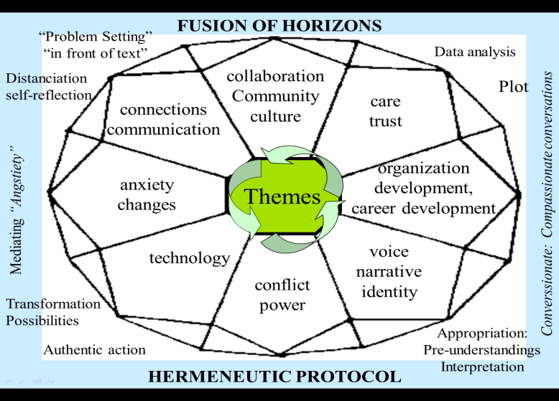
Classified ROCK!

Slide 12
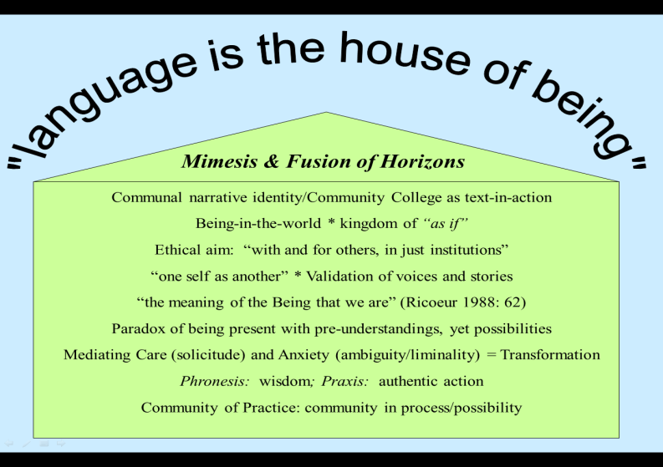
Classified ROCK!

Slide 13
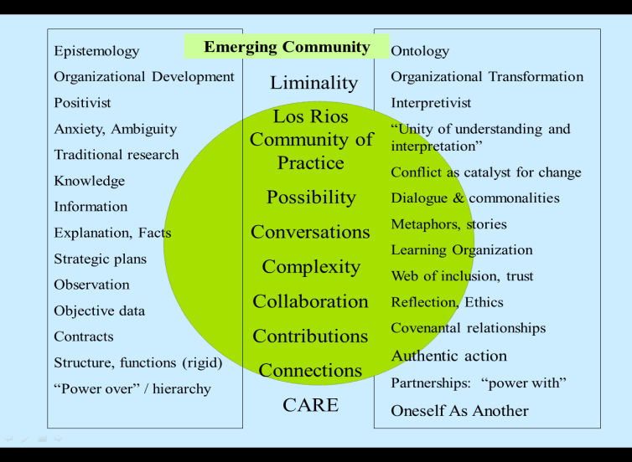
Classified ROCK!

Slide 14
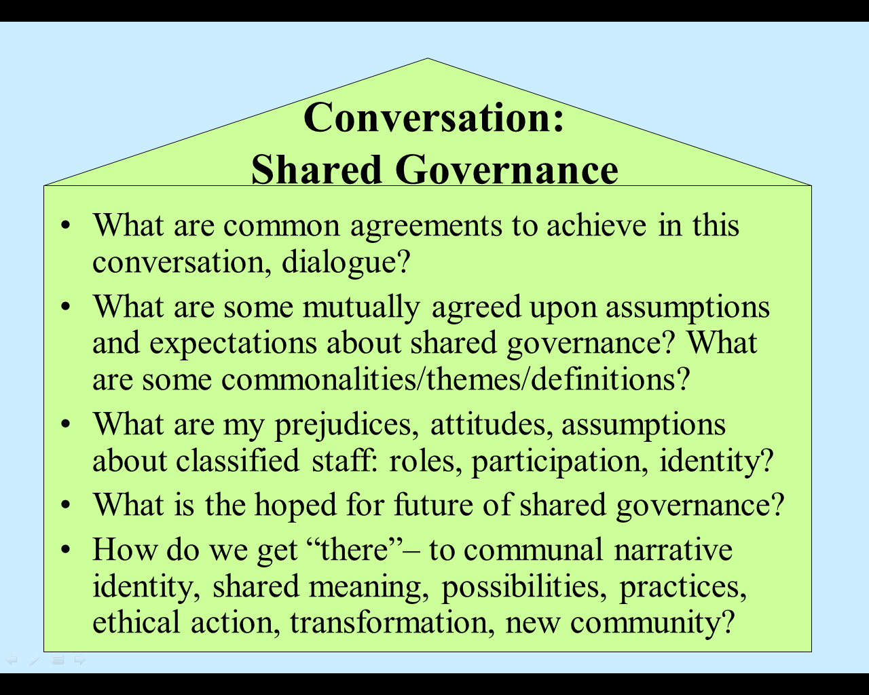
Classified ROCK!

Slide 15
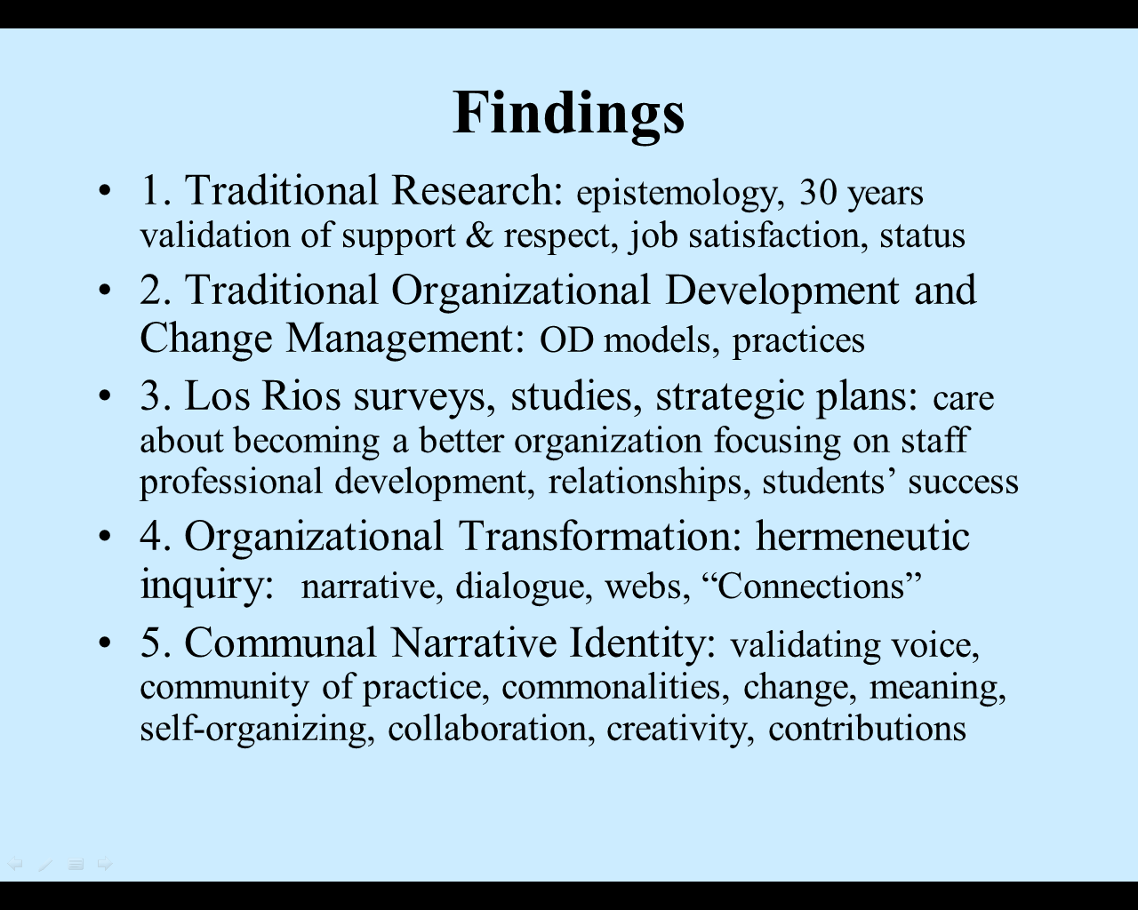
Classified ROCK!

Slide 16
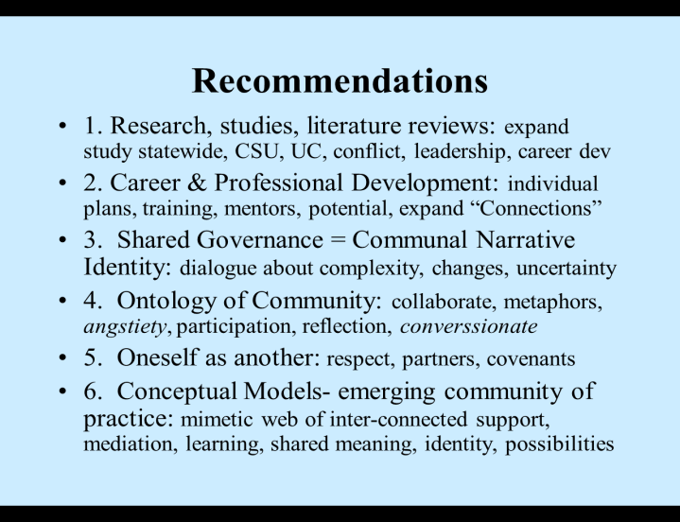
Classified ROCK!

Slide 17
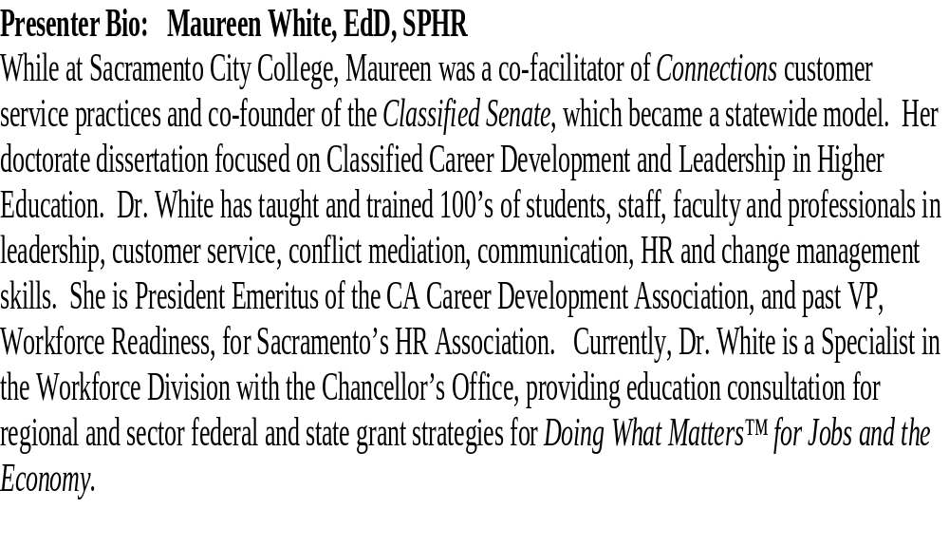
Classified ROCK!

Slide 18
Classified ROCK!
Reference:
A Celebration of Community, Conversation and Transformation: Communal Narrative Identity of Classified (Support) Staff in Higher Education. University of San Francisco, 2004
Maureen E. White, EdD: mwhite@CCCCO.edu
Dissertation posted on 4CS website?

